Slide 1


Sujit Kumar Pradhan
10-08-2023

Slide 2

Outline
Executive Summary
Introduction
Methodology
Results
Conclusion
Appendix

Slide 3
Executive Summary
Summary of methodologies
Data Collection using SpaceX API and Web scraping
Exploratory Data Analysis using SQL, Pandas and Matplotlib
Data Visualization using Seaborn and Folium
Interactive Visual analytics and Dashboard using Plotly
Predictive Analysis using machine Learning Algorithms
Summary of all results
Creating both Visual and Data driven analytics using the above methodologies to find out the answers to the Problem Statement

Slide 4
Introduction
Project background and context
SpaceX advertises Falcon 9 rocket launches on its website with a cost of 62 million dollars; other providers cost upward of 165 million dollars each, much of the savings is because SpaceX can reuse the first stage.
Determining whether the first stage will land and further determination of the cost of the same and using the above information to showcase SpaceX’s success and cost effectiveness against other companies’ bid.
Problems you want to find answers
Whether the Falcon 9 first stage will land successfully ?
Whether we can determine the cost of launch ?

Slide 5

Section 1

Slide 6
Methodology
Executive Summary
Data collection methodology:
Describe how data was collected
Perform data wrangling
Describe how data was processed
Perform exploratory data analysis (EDA) using visualization and SQL
Perform interactive visual analytics using Folium and Plotly Dash
Perform predictive analysis using classification models
How to build, tune, evaluate classification models

Slide 7
Data Collection
Data was first collected from SpaceX API through a get request to it done by defining a series of functions that would extract information using identification numbers in the launch data and then requesting launch data from the URL.
Finally to make the requested JSON results more consistent, they were decoded using .json() and turned into a Pandas dataframe using .json_normalize().

Slide 8
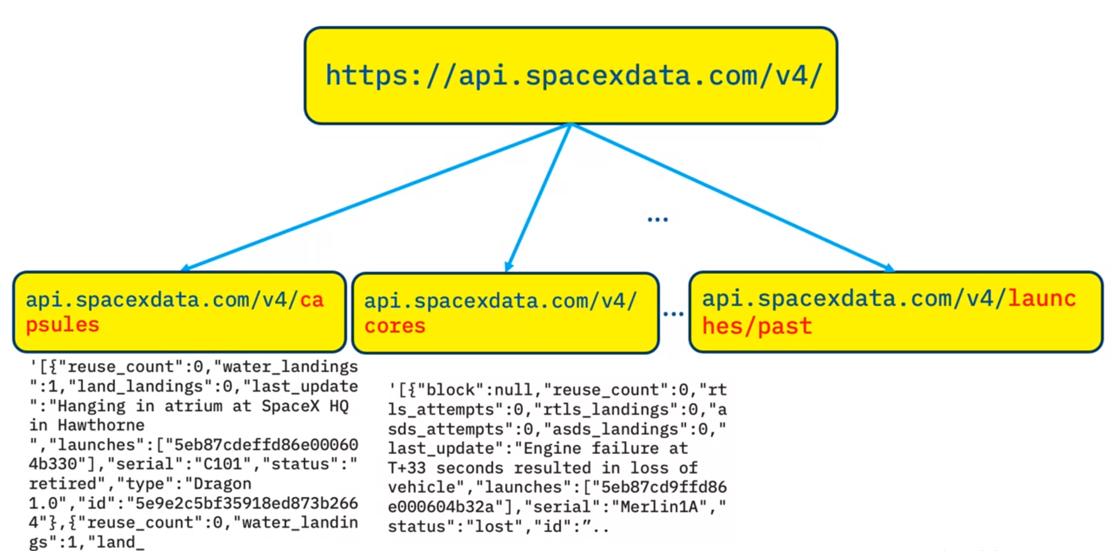
Data Collection – SpaceX API
SpaceX launch data gathered from SpaceX REST API which provides us data about launches, including information about the rocket used, payload delivered, launch specifications, landing specifications, and landing outcomes
URL :- https://api.spacexdata.com/v4/launches/past

Slide 9
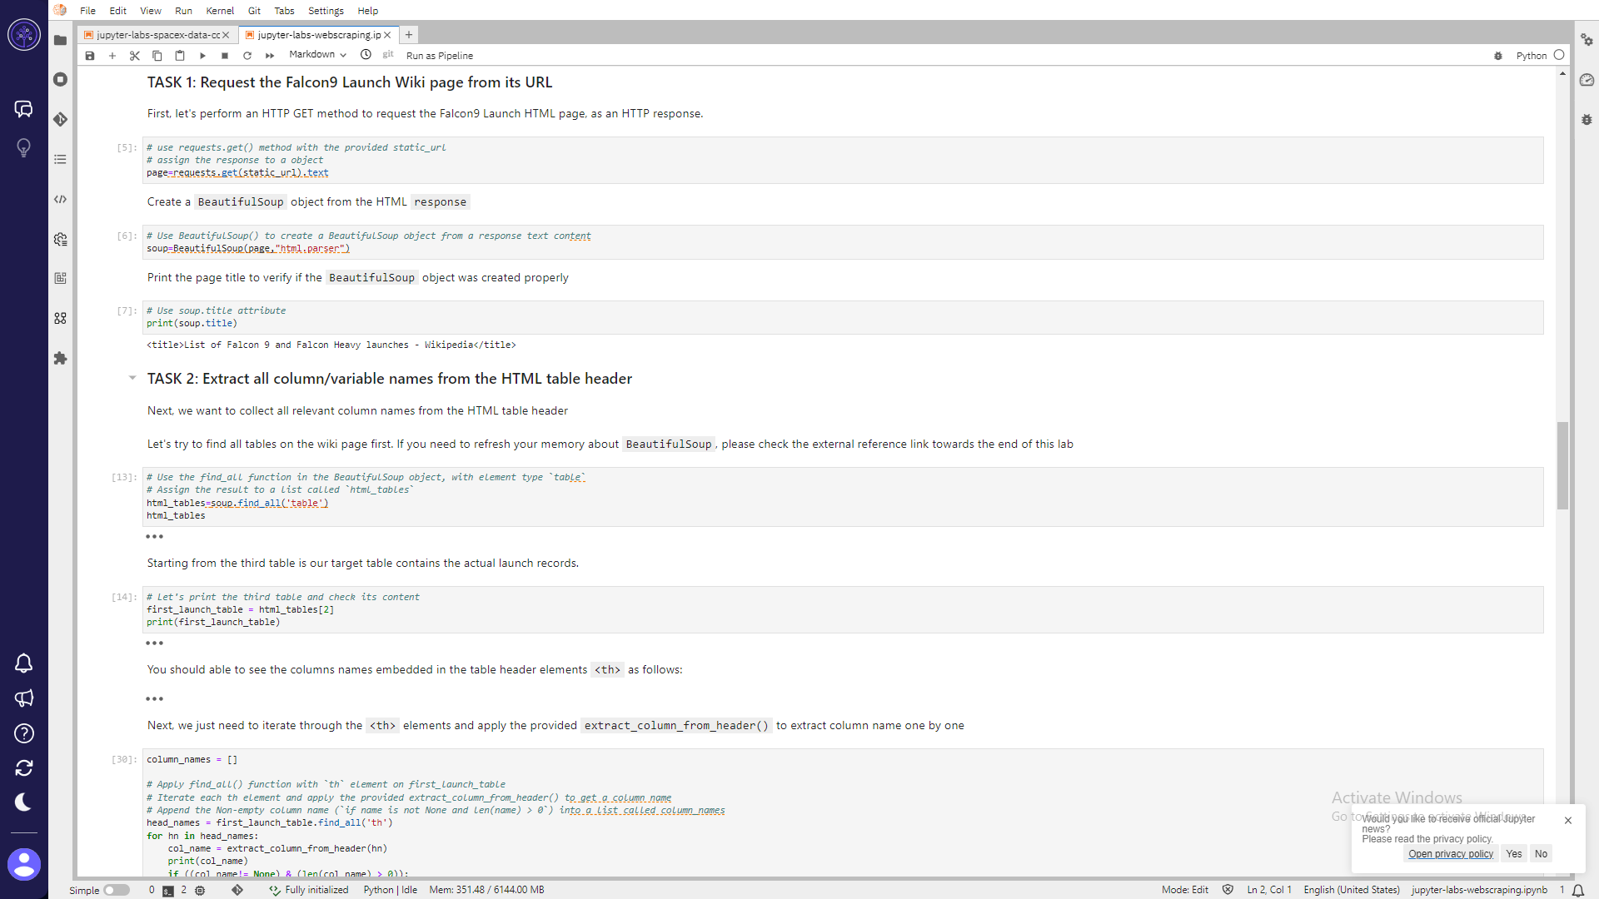
Data Collection - Scraping
Falcon 9 launch records are scraped with the help of `BeautifulSoup`object to Extract a Falcon 9 launch records HTML table from Wikipedia and the table is parsed and converted to a Pandas data frame
Add the GitHub URL of the completed web scraping notebook, as an external reference and peer-review purpose

Slide 10
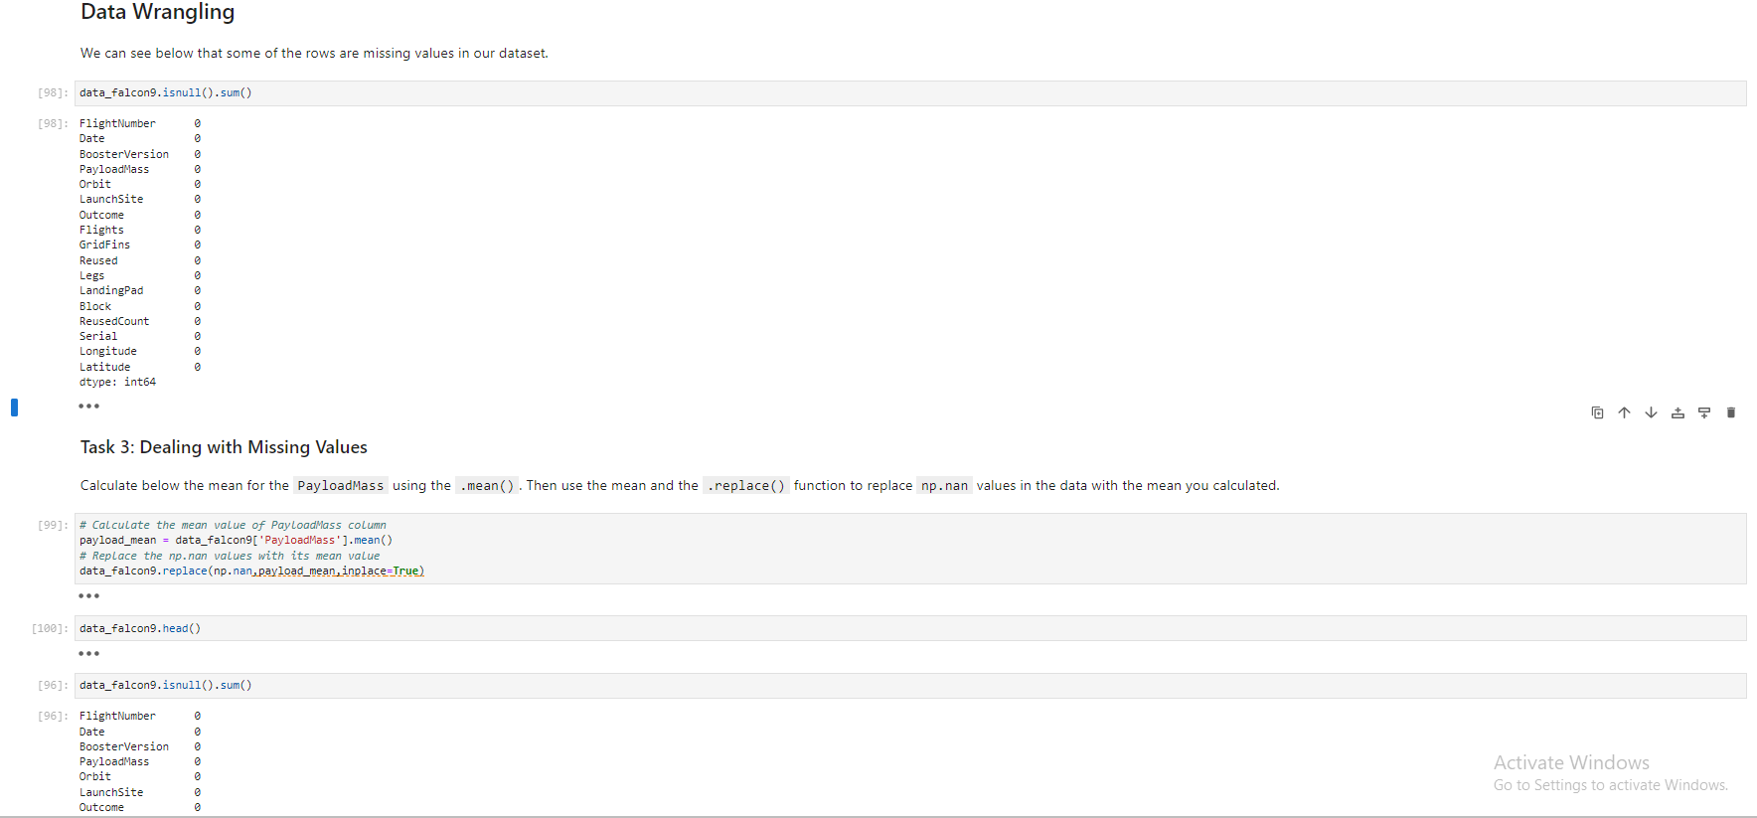
Data Wrangling
Once the dataframe is created, data is filtered only to keep the Falcon 9 launches, missing data values in respective columns dealt with.
Once the missing values are dealt with, a final check is done through isnulll().sum() in order to ensure that we have no missing values in our dataset.
Add the GitHub URL of your completed data wrangling related notebooks, as an external reference and peer-review purpose

Slide 11
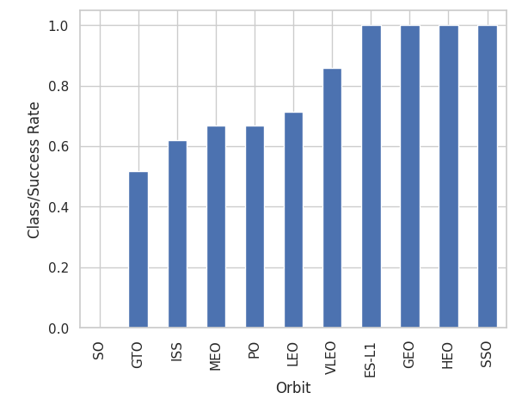
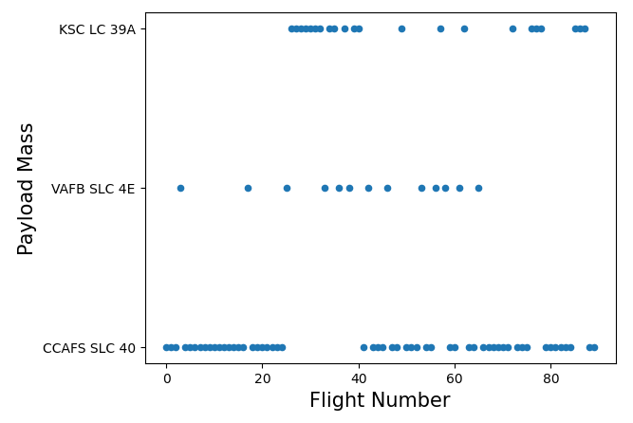
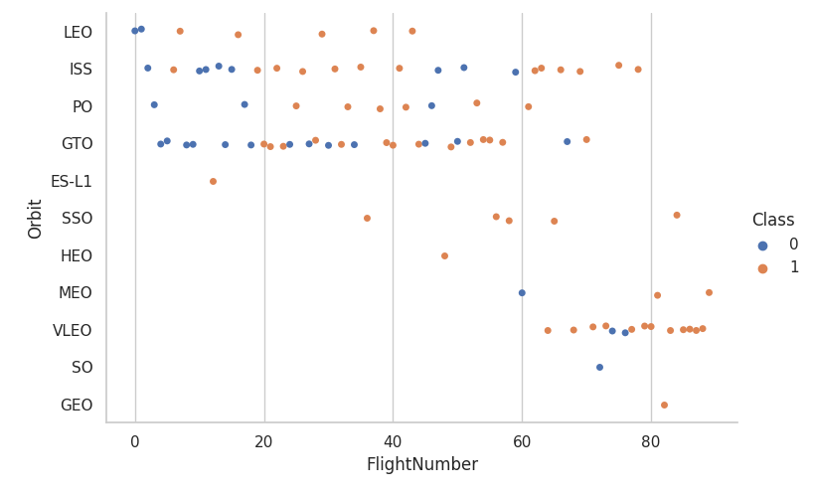
EDA with Data Visualization
The following charts were plotted for EDA with visualization :-
Scatterplots to visualize the relationship between ‘Flight number’ and ‘Launch Site’, between ‘Payload’ and ‘Launch Site’, between ‘Flight Number’ and ‘Orbit’ and so on
Bar Charts to visualize the relationship between success rate of each orbit type.
Line plots to visualize the yearly success trend of launches.
Add the GitHub URL of your completed EDA with data visualization notebook, as an external reference and peer-review purpose

Slide 12
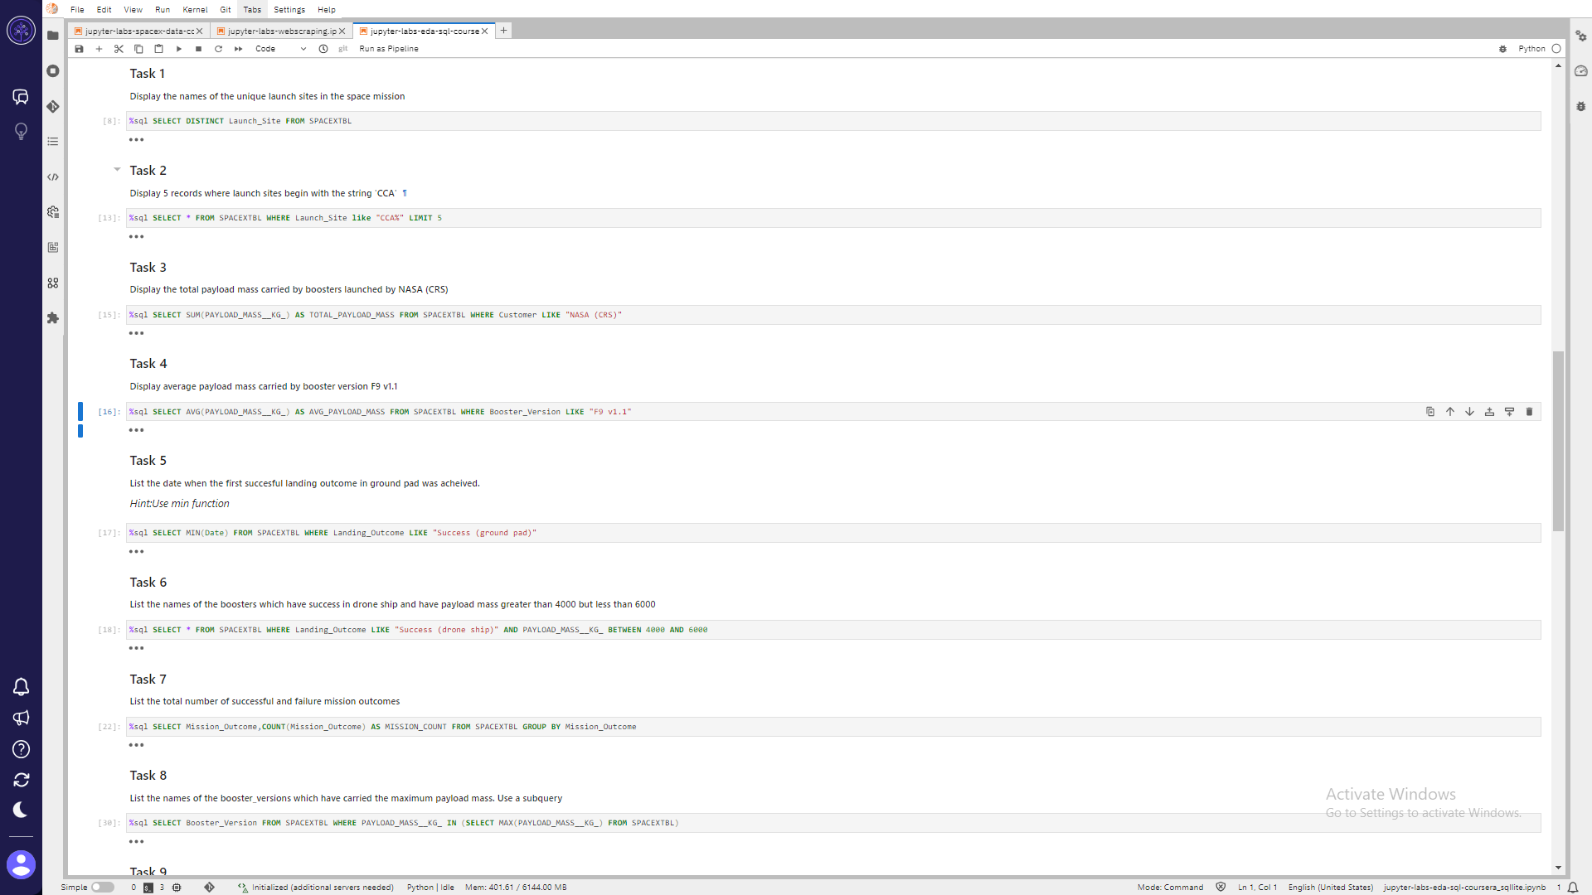
EDA with SQL
The following queries were used for EDA :
Add the GitHub URL of your completed EDA with SQL notebook, as an external reference and peer-review purpose

Slide 13
Build an Interactive Map with Folium
More interactive visual analytics were done using `Folium` to perform the following tasks :
Mark all launch sites on a map
Mark the success/failed launches for each site on the map
Calculate the distances between a launch site to its proximities
Add the GitHub URL of your completed interactive map with Folium map, as an external reference and peer-review purpose

Slide 14
Build a Dashboard with Plotly Dash
Built an interactive dashboard application by:
Adding a Launch Site Drop-down Input Component
Adding a callback function to render success-pie-chart based on selected site dropdown
Adding a Range Slider to Select Payload
Adding a callback function to render the success-payload-scatter-chart scatter plot
Add the GitHub URL of your completed Plotly Dash lab, as an external reference and peer-review purpose

Slide 15
Predictive Analysis (Classification)
Exploratory Data Analysis was performed and Training Labels were determined to :
create a column for the class
Standardize the data
Split into training data and test data
Find best Hyperparameter for SVM, Classification Trees and Logistic Regression
Find the method performs best using test dataYou need present your model development process using key phrases and flowchart
Add the GitHub URL of your completed predictive analysis lab, as an external reference and peer-review purpose

Slide 16
Results
Exploratory data analysis results
Interactive analytics demo in screenshots
Predictive analysis results

Slide 17

Section 2

Slide 18
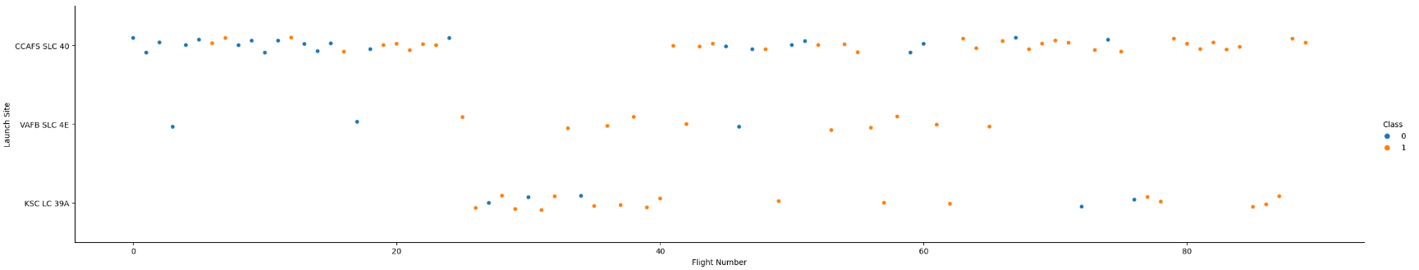
Flight Number vs. Launch Site

Slide 19
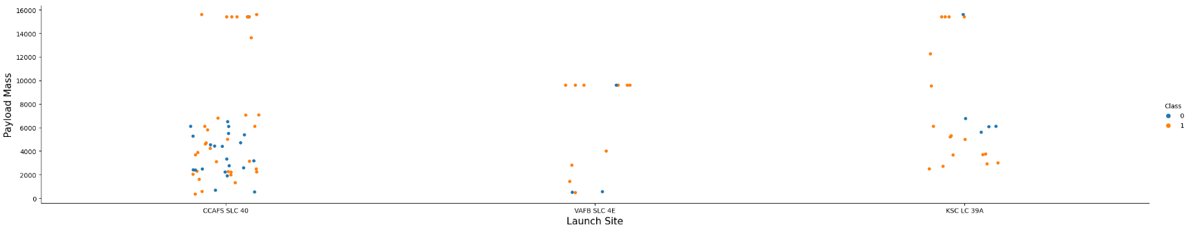
Payload vs. Launch Site
For the VAFB-SLC launch site there are no rockets launched for heavy payload mass(greater than 10000).

Slide 20
Success Rate vs. Orbit Type

Slide 21
Flight Number vs. Orbit Type
In the LEO orbit the Success appears related to the number of flights; on the other hand, there seems to be no relationship between flight number when in GTO orbit.

Slide 22
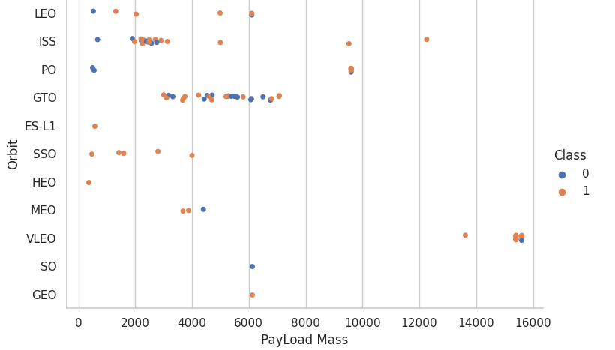
Payload vs. Orbit Type
With heavy payloads the successful landing or positive landing rate are more for Polar,LEO and ISS.
However for GTO we cannot distinguish this well as both positive landing rate and negative landing(unsuccessful mission) are both there here.

Slide 23
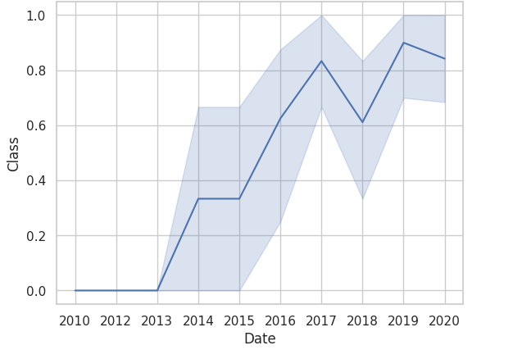
Launch Success Yearly Trend
the sucess rate since 2013 kept increasing till 2020

Slide 24
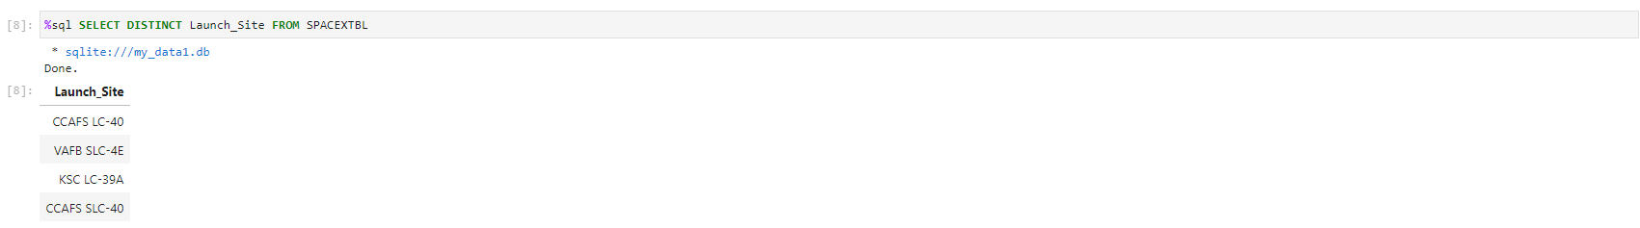
All Launch Site Names

Slide 25
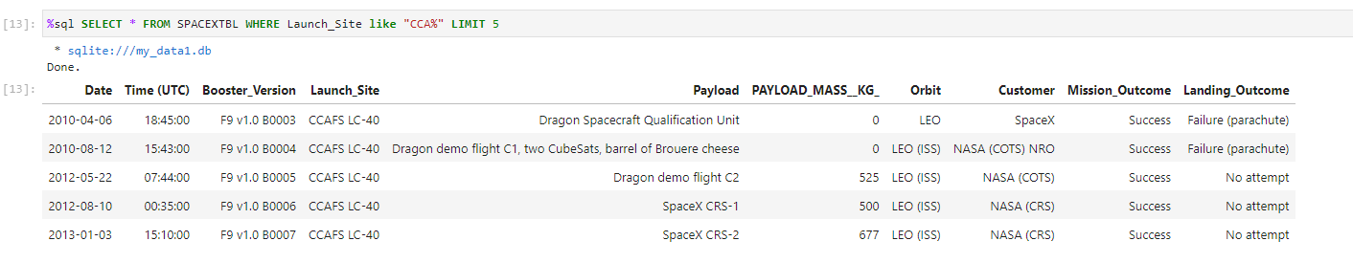
Launch Site Names Begin with 'CCA'

Slide 26
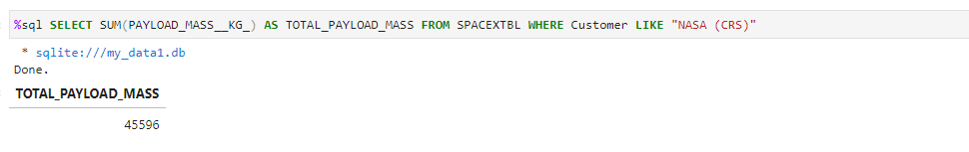
Total Payload Mass

Slide 27
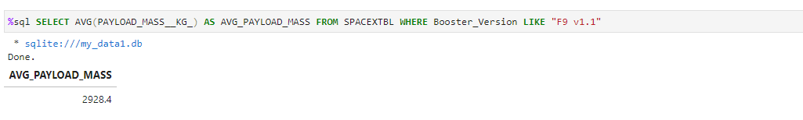
Average Payload Mass by F9 v1.1

Slide 28
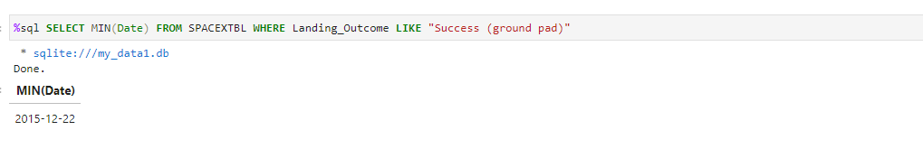
First Successful Ground Landing Date

Slide 29
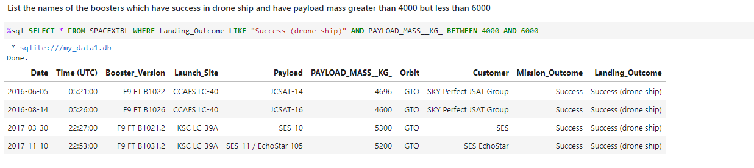
Successful Drone Ship Landing with Payload between 4000 and 6000

Slide 30
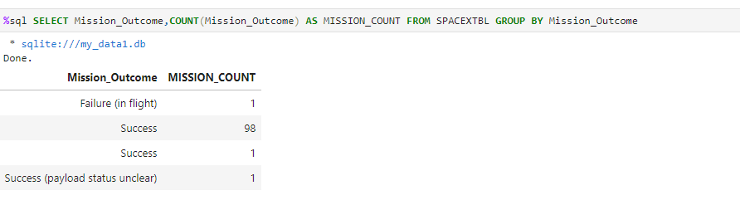
Total Number of Successful and Failure Mission Outcomes

Slide 31
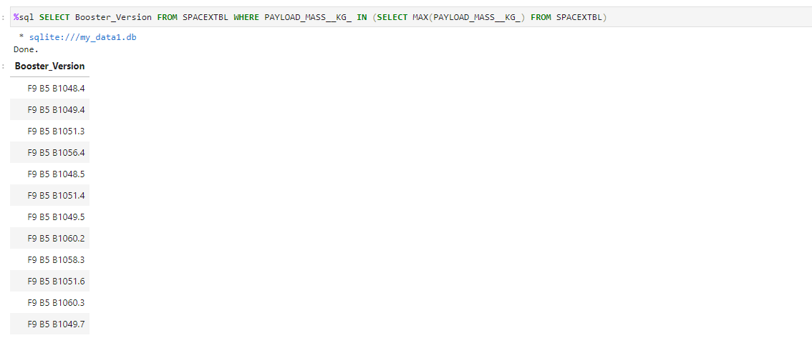
Boosters Carried Maximum Payload

Slide 32
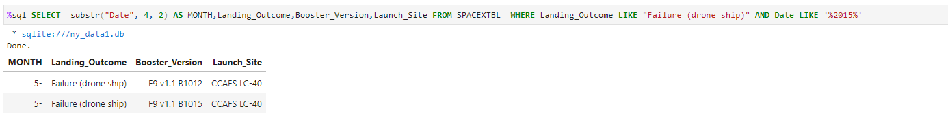
2015 Launch Records

Slide 33
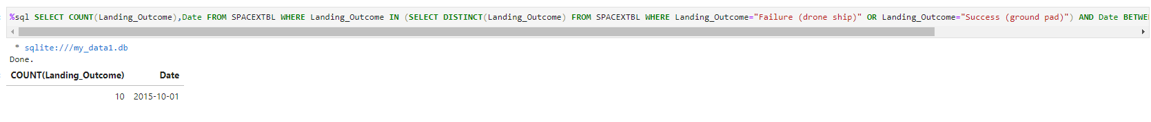
Rank Landing Outcomes Between 2010-06-04 and 2017-03-20

Slide 34

Section 3

Slide 35
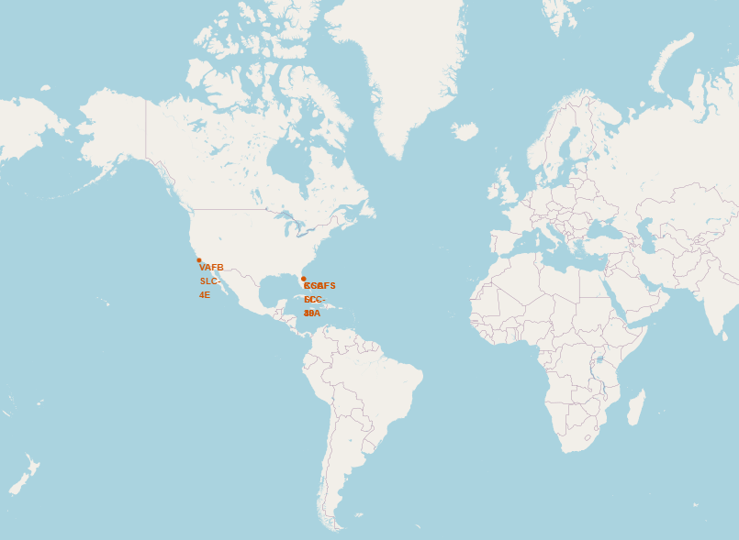
Mark all launch sites on a map
All launch sites are in proximity of the Equator and in close proximity to coasts as well.

Slide 36
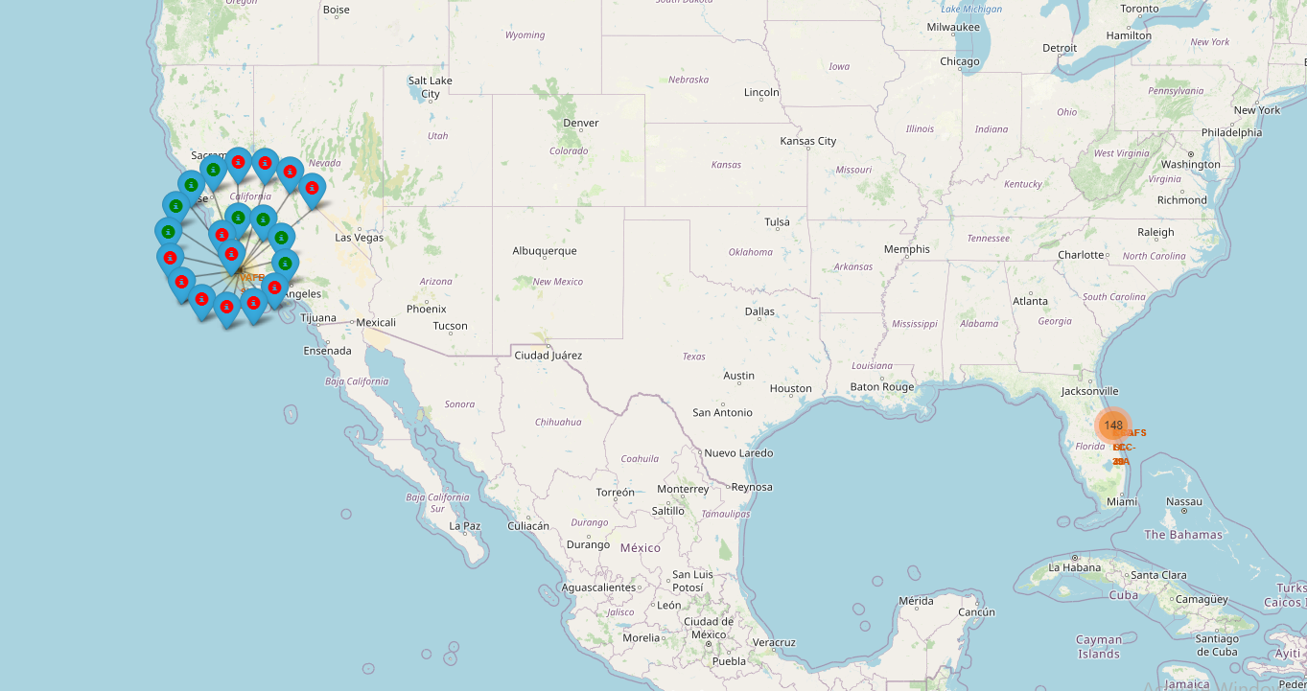
Mark the success/failed launches for each site on the map
In the Eastern coast (Florida) Launch site KSC LC-39A has relatively high success rates compared to CCAFS SLC-40 & CCAFS LC-40

Slide 37
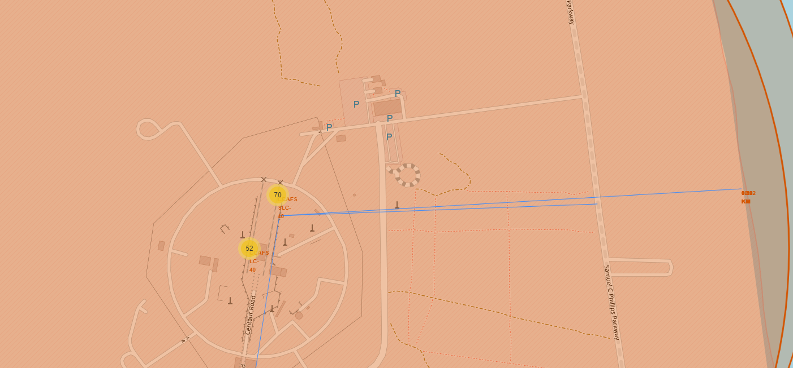
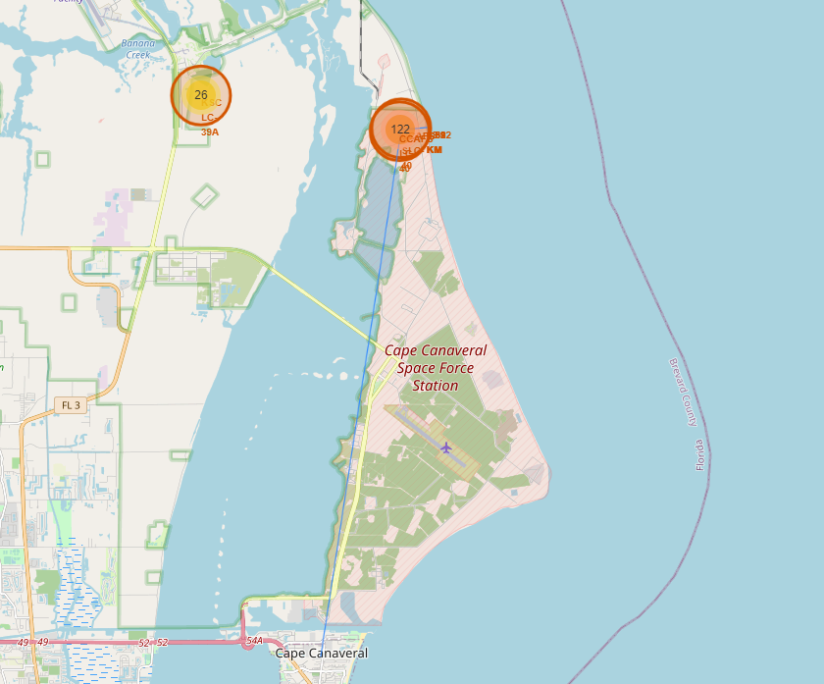
CCAFS SLC-40 is 0.1 km,0.59 km and 18.22 km from the nearest rail line, highway and city respectively
Calculate the distances between a launch site to its proximities

Slide 38

Section 4

Slide 39
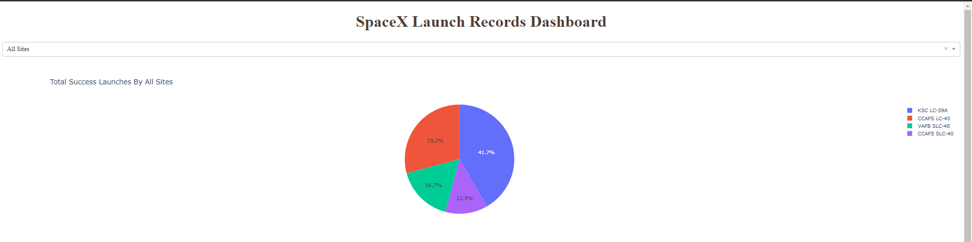
• Launch site KSC LC-39A has the highest launch success rate at 42% followed by CCAFS LC-40 at 29%, VAFB SLC-4E at 17% and lastly launch site CCAFS SLC-40 with a success rate of 13%
Pie chart for the launch site with 2nd highest launch success ratio

Slide 40
Pie chart for the launch site with 2nd highest launch success ratio
Launch site CCAFS LC-40 had the 2nd highest success ratio of 73% success against 27% failed launches

Slide 41
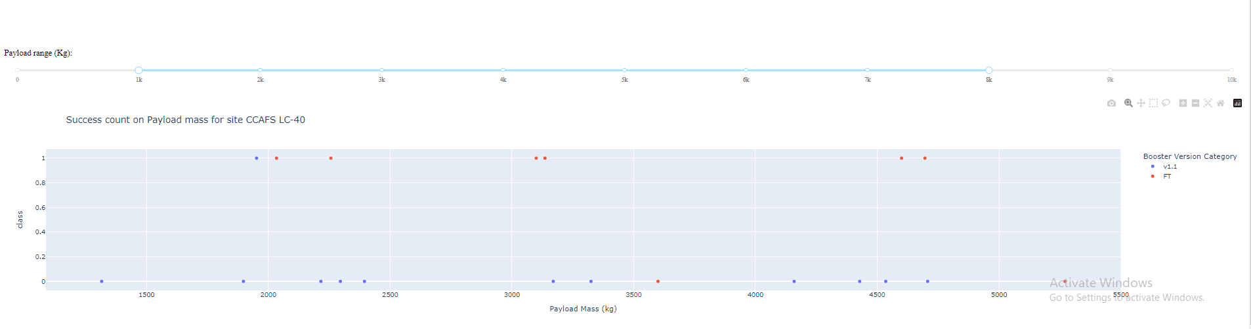
Payload vs. Launch Outcome scatter plot for all sites
For Launch site CCAFS LC-40 the booster version FT has the largest success rate from a payload mass of >2000kg

Slide 42

Section 5

Slide 43
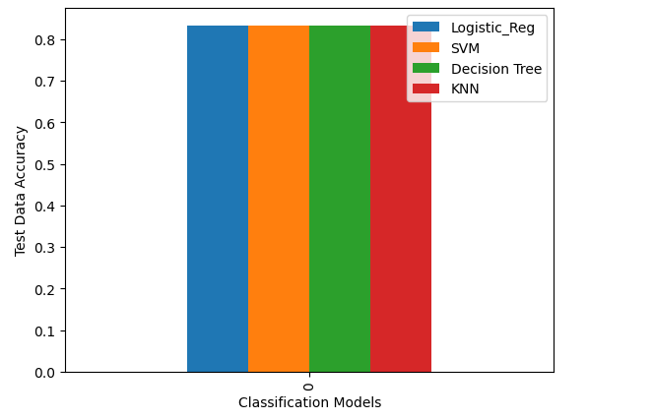
Classification Accuracy
All the classification models have the same test accuracy.

Slide 44
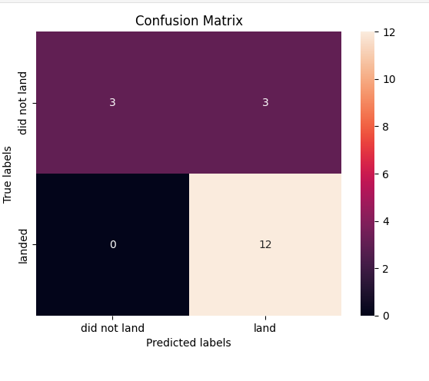
Confusion Matrix
All the 4 classification model had the same confusion matrixes and were able equally distinguish between the different classes. The major problem is false positives for all the models.

Slide 45
Conclusions
Different launch sites have different success rates. CCAFS LC-40, has a success rate of 60 %, while KSC LC-39A and VAFB SLC 4E has a success rate of 77%.
• We can deduce that, as the flight number increases in each of the 3 launch sites, so does the success rate. For instance, the success rate for the VAFB SLC 4E launch site is 100% after the Flight number 50. Both KSC LC 39A and CCAFS SLC 40 have a 100% success rates after 80th flight
• In Payload Vs. Launch Site scatter point chart ,the VAFB-SLC launch site has no rockets launched for heavy payload mass(greater than 10000).
• Orbits ES-L1, GEO, HEO & SSO have the highest success rates at 100%, with SO orbit having the lowest success rate at ~50%. Orbit SO has 0% success rate.
• LEO orbit the Success appears related to the number of flights; on the other hand, there seems to be no relationship between flight number when in GTO orbit Conclusions 57
• With heavy payloads the successful landing or positive landing rate are more for Polar, LEO and ISS. However for GTO we cannot distinguish this well as both positive landing rate and negative landing(unsuccessful mission) are both there here
• The success rate since 2013 kept increasing till 2020.

Slide 46
Appendix
Include any relevant assets like Python code snippets, SQL queries, charts, Notebook outputs, or data sets that you may have created during this project

Slide 47


